Slide 1
“Teach A Level Maths”
Statistics 1
Discrete Random Variables
© Christine Crisp

Slide 2
Statistics 1
AQA
EDEXCEL
OCR
"Certain images and/or photos on this presentation are the copyrighted property of JupiterImages and are being used with permission under license. These images and/or photos may not be copied or downloaded without permission from JupiterImages"

Slide 3
Suppose we roll an ordinary 6-sided die sixty times and record the number of ones, twos, etc.
We might get
Number on die | 1 | 2 | 3 | 4 | 5 | 6
Frequency | 12 | 9 | 11 | 10 | 7 | 11
If I asked you what you might expect to happen if we went on rolling the die you might say that you would expect roughly the same number of ones, twos, etc.
In saying this, you would be using a perfectly reasonable model.
Models in Statistics describe situations and are used to make predictions.

Slide 4








We could write the model out as a table:
x
P
P
(X = )
x gives the value of the number shown on the die.
It is a variable which can be any value from 1 to 6.
We let X be a description of the variable, so:
“ X is the number shown on the face of the die”
We label the 2nd row .
P
(X = )
If x = 1, for example, we get P(X = 1) which means the probability that the number shown on the die is 1.

Slide 5

So, we have
x
P(X = )

Slide 6

So, we have
x
P(X = )

Slide 7

So, we have
x
P(X = )

Slide 8

So, we have
x
P(X = )

Slide 9

So, we have
x
P(X = )

Slide 10

So, we have
x
P(X = )

Slide 11

So, we have
x
P(X = )

Slide 12
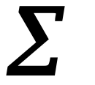
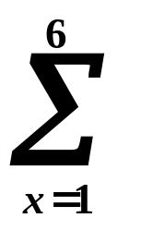



So, we have
x
P(X = )
This table shows the probability distribution of X.
If we add up ( sum ) the probabilities we get
is the Greek capital letter S and stands for Sum
So we can write
The sum from 1 to 6 of
the probabilities of all the values of X, ( x = 1, 2, 3, 4, 5, 6 )
equals 1

Slide 13
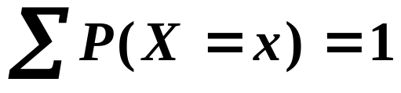
A variable where the sum of the probabilities of all its possible values is equal to 1 is called a random variable ( r.v. ).
So, in our example, X is the random variable
“ the number shown on the face of the die”
We can usually see what values the random variable can have, so we don’t need to show them on the summation sign.
So, we often write
X is an example of a discrete random variable. It takes certain values only.
In the example these values were the integers from 1 to 6. ( In exercises the numbers are often integers but they don’t have to be. )

Slide 14

SUMMARY
A statistical model uses probabilities to describe a situation and to make predictions.
A probability distribution gives the probabilities for a random variable.
A variable where the sum of the probabilities of all its possible values is equal to 1 is called a random variable (r.v.). If X takes only certain values in an interval, X is a discrete random variable.
If X is a discrete random variable, then
N.B.
X describes the r.v.
x gives the values of the r.v.

Slide 15




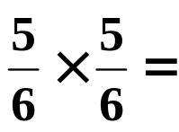


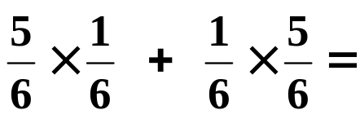



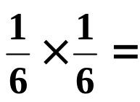



e.g. 1
Let X be the variable “ the number of sixes showing when 2 dice are rolled”. Show that X is a random variable and write its probability distribution in a table.
Solution:
We can have 0 sixes, 1 six or 2 sixes:
Using for “not a 6 ” we can write the possibilities as
We want to show that , so we need to find the probabilities of getting 0, 1 or 2 sixes.
Then,
Tip: It will be easier to add the fractions if we don’t cancel

Slide 16
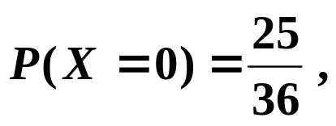
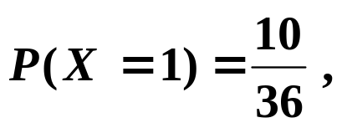
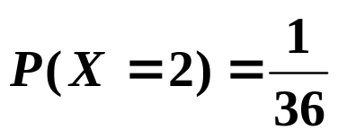
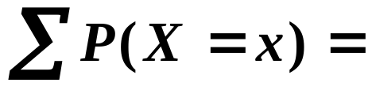
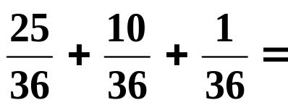
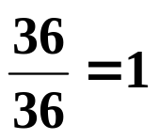






So,
Since , X is a random variable.
The probability table is
x
P
(X = )

Slide 17

So,
Since , X is a random variable.
The probability table is
x
P
(X = )
This is an example of a discrete random variable because the variable takes only some values in an interval rather than every value.

Slide 18
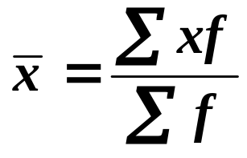
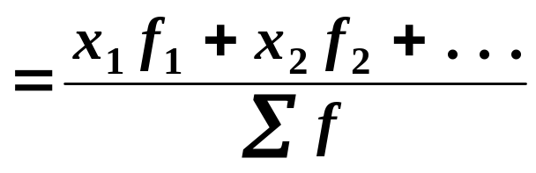
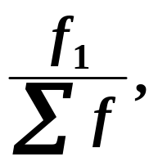
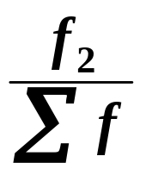



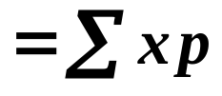
The Mean of a Discrete Random Variable
We can find the mean of a discrete random variable in a similar way to that used for data.
Suppose we take our first example of rolling a die.
Number on die | 1 | 2 | 3 | 4 | 5 | 6
Frequency | 12 | 9 | 11 | 10 | 7 | 11
The mean is given by
But, . . . can be replaced by , . . . the probabilities of getting 1, 2, . . .
1st x-value × 1st frequency
So, the mean

Slide 19
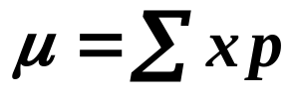

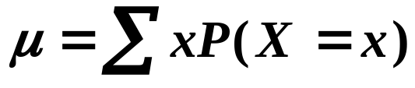
Notation for the Mean of a Discrete Random Variable
When dealing with a model, we use the letter μ for the mean (the greek letter m).
pronounced “mew”
We write
or, more often, replacing p by ,
Instead of μ, we can also write E(X).
This notation comes from the idea of the mean being the Expected value of the r.v. X.

Slide 20
Notation for the Mean of a Discrete Random Variable
When dealing with a model, we use the letter μ for the mean (the greek letter m).
pronounced “mew”
We write
or, more often, replacing p by ,
Instead of μ, we can also write E(X).
This notation comes from the idea of the mean being the Expected value of the r.v. X.
( Think of this as being what we expect to get on average ).

Slide 21



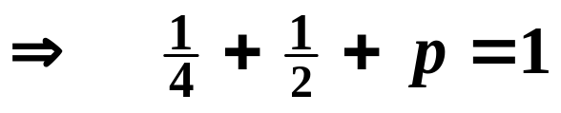
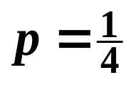

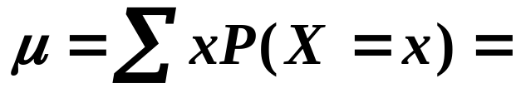
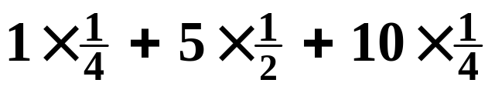
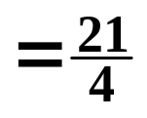

e.g. 1. A random variable X has the probability distribution
x
P
(X = )
p
Find (a) the value of p and (b) the mean of X.
Solution:
(a) Since X is a discrete r.v.,
(b) mean,
Tip: Always check that your value of the mean lies within the range of the given values of x. Here, or 5·25, does lie between 1 and 10.

Slide 22
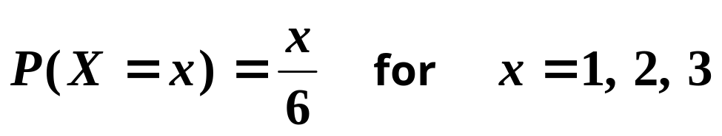




The probabilities in a probability distribution can sometimes be given by a formula.
The formula is called a probability density function ( p.d.f. ).
e.g. 1. Write out a probability distribution table for the r.v. X where
Solution:
x
P
(X = )

Slide 23


The probabilities in a probability distribution can sometimes be given by a formula.
The formula is called a probability density function ( p.d.f. ).
e.g. 1. Write out a probability distribution table for the r.v. X where
Solution:
x
P
(X = )
These probabilities can be shown on a diagram.

Slide 24








x
P
(X = )
This is called a stick diagram.

Slide 25
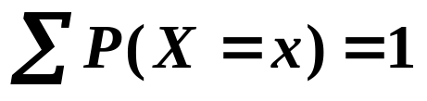



e.g. 2. Find the value of the constant k for the random variable X with p.d.f. given by
Solution:
Since X is a discrete random variable,
So,

Slide 26
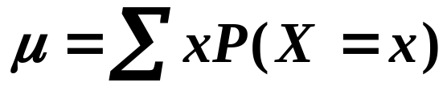
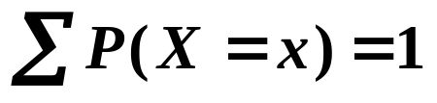
SUMMARY
The mean, μ , of a discrete random variable is given by
The mean is also referred to as the expectation or expected value of the r.v.
μ can be written as E(X)
The probabilities can be given by a formula called the probability density function ( p.d.f. )
An unknown constant in the p.d.f. can be found by using

Slide 27







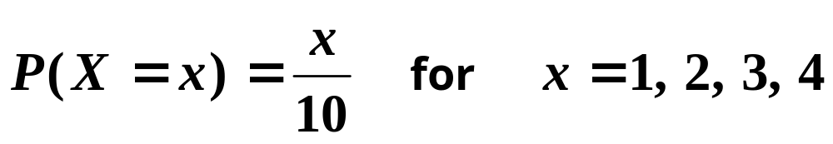
Exercise
1. The tables show the probability distributions of 2 random variables. For each, find (i) the value of p (ii) the mean value.
(a)
(b)
x
x
P
(X = )
p
P
(X = )
p
2. Write out the probability distribution for the random variable, X, where the probability distribution function is

Slide 28

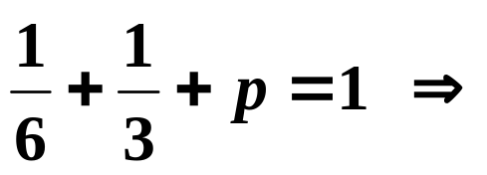
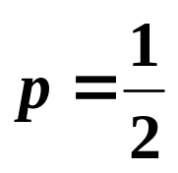
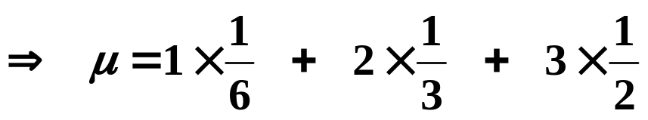
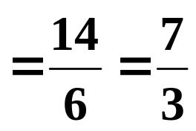




Solution:
X is a random variable:
1(a)
x
P
(X = )
p
mean,
(b)
x
P
(X = )
p
mean,

Slide 29









2. Write out the probability distribution for the random variable, X, where the probability distribution function is
Solution:
x
P(X = x )

Slide 30


2. Write out the probability distribution for the random variable, X, where the probability distribution function is
Solution:
x
P(X = x )

Slide 31
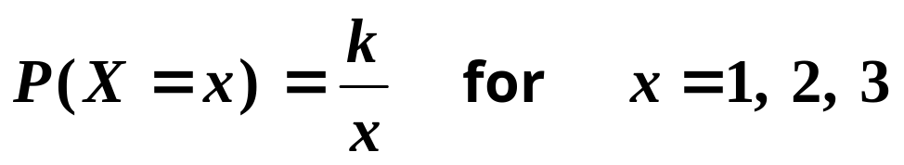
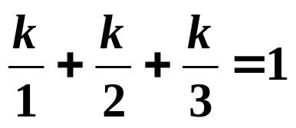
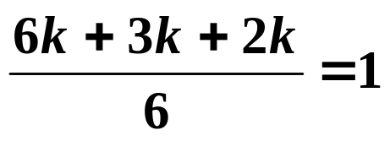

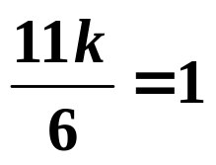
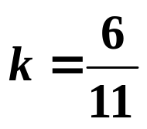
Exercise
3. Find the exact value of the constant k for the random variable X with p.d.f. given by
Solution:
Since X is a discrete random variable,
So,

Slide 32
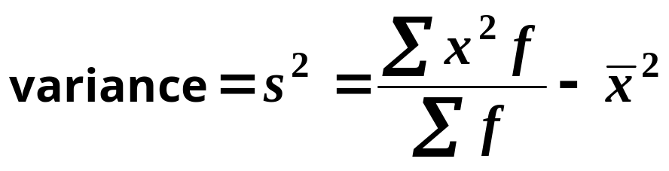
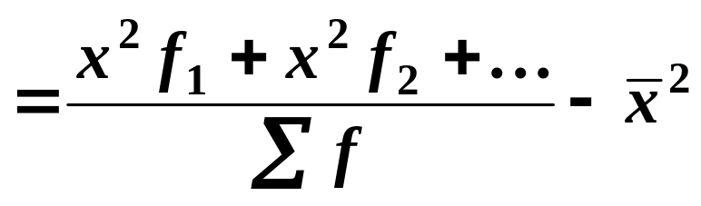
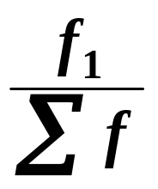

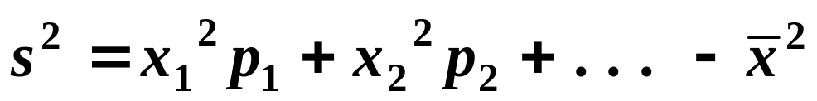
Variance of a Discrete Random Variable
The variance of a discrete random variable is found in a similar way to the one we used for the mean.
For a frequency distribution, the formula is
Replacing by etc. gives

Slide 33



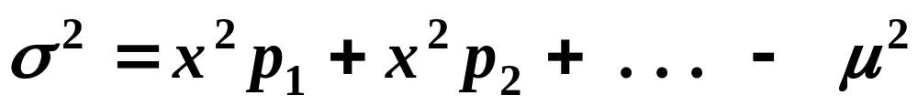
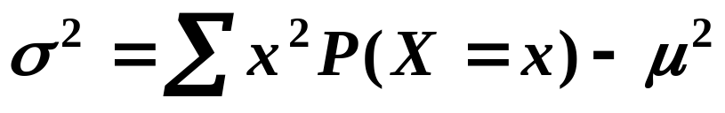

But we must replace by and we replace s by the letter ( which is the Greek lowercase s, pronounced sigma ).
So,
( Notice that this expression contains the Greek capital S, Σ, and the lowercase s, σ. )
The variance of X is also written as Var(X).

Slide 34
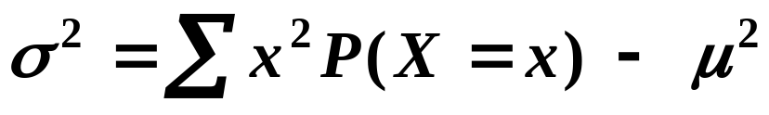

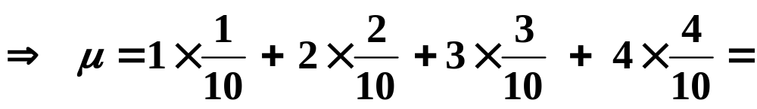
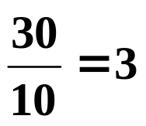

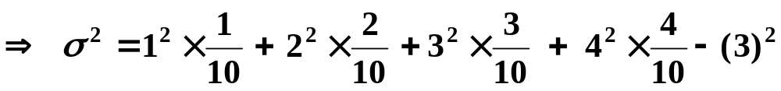
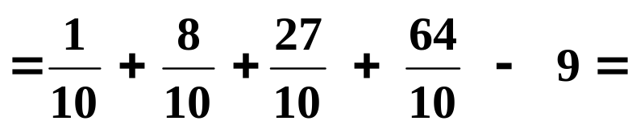
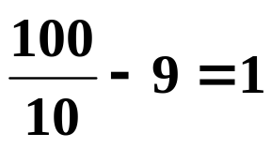
e.g. 1 Find the variance of X for the following:
x
P(X = x )
Solution:
We first need to find the mean, μ :
Tip: With a bit of practice you’ll find you can simplify the fractions without a calculator. It’s quicker and more accurate. Try these before you see my answer.

Slide 35






SUMMARY
The mean of a discrete random variable is given by
The variance, , of a discrete random variable is given by
N.B.
For frequency distributions use and for the mean and variance ( the “English” alphabet ).
For probability distributions ( models ) use and ( the Greek alphabet ).

Slide 36










Exercise
1. Find the variance of X for each of the following:
(a)
(b)
x
x
P
(X = )
P
(X = )
Solution:
(a)

Slide 37





Exercise
(b)
x
P
(X = )
Solution:

Slide 38


Slide 39
The following slides contain repeats of information on earlier slides, shown without colour, so that they can be printed and photocopied.
For most purposes the slides can be printed as “Handouts” with up to 6 slides per sheet.

Slide 40
SUMMARY
A statistical model uses probabilities to describe a situation and to make predictions.
A probability distribution gives the probabilities for a model.
A variable where the sum of the probabilities of all its possible values is equal to 1 is called a random variable (r.v.). If X takes only certain values in an interval, X is a discrete r.v.
If X is a discrete random variable ( r.v. ), then
N.B.
X describes the r.v.
x gives the values of the r.v.

Slide 41

The Mean of a Discrete Random Variable
We can find the mean of a discrete random variable in a similar way to that for data.
Suppose we take our first example of rolling a die.
Number on die
1
2
3
4
5
6
Frequency
12
9
11
10
7
11
The mean is given by
But, . . . can be replaced by , . . . the probabilities of getting 1, 2, . . .
So, the mean

Slide 42

Notation for the Mean of a discrete Random Variable
When dealing with a discrete random variable, we use the letter μ ( pronounced mew ) for the mean (the greek letter m).
We write
or, more often, replacing p by ,
Instead of μ, we can also write E(X).
The notation comes from the idea of the mean being the Expected value of the r.v. X.
( Think of this as being what we expect to get on average ).

Slide 43
e.g. 1
Let X be the variable “ the number of sixes showing when 2 dice are rolled”. Show that X is a random variable and write its probability distribution in a table.
Solution:
We can have 0 sixes, 1 six or 2 sixes:
Using for “ not a 6 “ we can write the possibilities as
Then,

Slide 44
So,
The probability table is
x
P
(X = )

Slide 45
SUMMARY
The mean, μ , of a discrete random variable is given by
The mean is also referred to as the expectation or expected value of the r.v.
μ can be written as E(X)
The probabilities can be given by a formula called the probability density function ( p.d.f. )

Slide 46




Variance of a Discrete Random Variable
For a frequency distribution, the formula is
Replacing by etc. gives
But for a random variable, we must replace by and we replace s by the letter (the greek s, pronounced sigma ). So,
The variance of X is also written as Var(X).

Slide 47
e.g. 1 Find the variance of X for the following:
x
P(X = x )
Solution:
We first need to find the mean, μ :

Slide 48
SUMMARY
The mean, μ , of a discrete random variable is given by
The variance, , of a discrete random variable is given by
N.B.
For frequency distributions use and for the mean and variance ( the “English” alphabet ).
For probability distributions ( models ) use and ( the Greek alphabet ).

